Slide 1
West Coast Project and Accommodation Update
Hydro Tasmania Project and Engagement Teams

Slide 2
Introductions
Hydro team
Aline Puchalski – Project manager
Ian Sutcliffe – Outage Manager
Nigel Robotham – Delivery Manager
Breandan McKeown – Engagement Advisor
Anneke le Roux – Engagement Officer

Slide 3
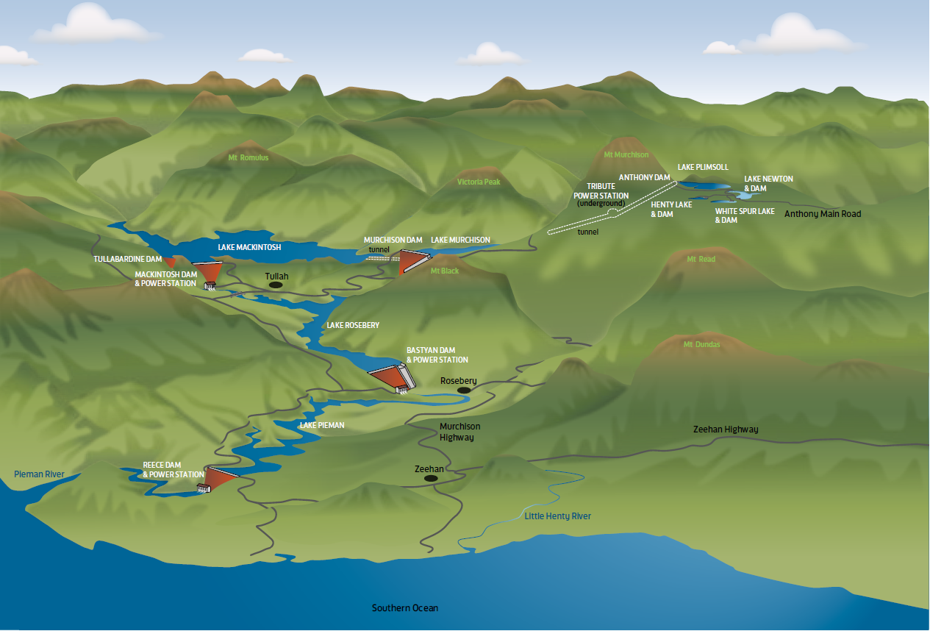
Program overview
Hydro Tasmania (HT) will be commencing a large power station refurbishment* program on the West Coast (WC). This work will take place on our Anthony-Pieman, King and Yolande hydropower schemes.
*refurbishment refers to major upgrades such as turbines, shafts and ancillary components of a power station machine.

Slide 4
Community Engagement Update

Slide 5









Social Impact Assessment In 2022/2023 the Engagement Team undertook desktop and field research on the WC to investigate and understand the socio-economic complexities of this region. This is a standard base step that should be undertaken for any large project or where there may be significant impacts on a community.
SIA Findings
Our research identified the following 4 key areas of impact and opportunity:
Infrastructure
Housing
Local Industry and Economic Development
Services

Slide 6
West Coast Community Perception Survey
The West Coast Perception Survey aimed to gather community feedback on living conditions, challenges, and future needs in the region, as well as thoughts and views on Hydro’s presence on the West Coast.
Objective: To understand residents' experiences and perceptions of life on the West Coast of Tasmania.
Total Participants: 241 individuals from various towns including Queenstown, Strahan, Zeehan, Tullah and Rosebery.
Key Focus Areas:
Reasons why the West Coast is a great place to live.
Challenges and difficulties faced by residents.
Community needs and areas of improvement (e.g., health, education, employment).
Hydro’s contribution to the region.
Survey Outcome: The survey has captured diverse perspectives on the strengths and challenges of living in the West Coast region, along with Hydro Tasmania’s input.
Key Themes:
Strong sense of community and connection to the natural environment.
Challenges include access to services, isolation, and economic opportunities.
A clear need for improvements in health, education, and employment opportunities.
Next Steps for Hydro:
Use the survey insights to guide future community planning and initiatives.
Engage in further discussions to address the identified challenges and build on the strengths of the region.

Slide 7
Community initiatives to date
Table 1: Current initiatives – completed or underway
Initiative | Outcomes | Current status | Next steps
Regional Connectivity Project: Energising Tullah – Power connectivity through advanced telecommunications (completed) | $200K funding contribution from Hydro Will deliver 11km optical fibre extension to Tullah | No changes to the project deliverables or timeline - completion expected July 2025. | Lobbying retail service providers to initiate upgrades to telecommunications networks in the region
Donations to Zeehan and Rosebery Neighbourhood houses (completed) | Provided games, a cinema setup, and a pool table to create a safe, engaging space for teens and promote community connection. Provided IGA gift cards to Zeehan community members in need, and craft supplies to a local craft group. | Recreational equipment is attracting teens – pool table used daily and other activities popular seasonally IGA gift cards provided vital support. Craft group (10-15 attendees) use donated supplies weekly. | We are working internally to try to make more community donations in the next phase of the project
Funded Mental Health First Aid training in Zeehan & Strahan (completed) | MHFA training accredited 29 West Coast locals to recognise, support, and connect with individuals facing mental health challenges | Training completed | Work with the community to identify more areas we can help improve
Western Strategic Partnerships Group membership (ongoing) | Illustrates Hydro’s broader commitment to the region | Ongoing contribution to the group

Slide 8
Project and Accommodation Update

Slide 9


Refurbishment Projects Key facts
Refurbishment of the turbines located at Bastyan, Mackintosh, Reece and then Tribute and John Butters Power Stations so they operate for another 40+ years.
Project Start date: September 2027 – Bastyan
Duration: Each refurbishment will take approximately 9 months
Workforce: Up to 80 additional workers (HT staff & contractors) at peak times
Commitment: We will actively work to minimize impacts and maximize benefits for the local community. Job opportunities associated with the ongoing management of the accommodation village will be advertised locally.

Slide 10
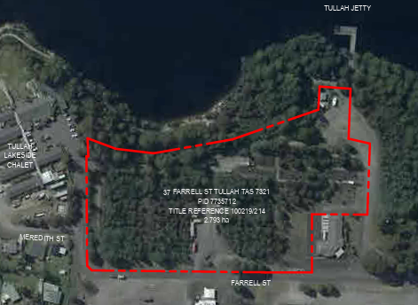
Accommodation Overview
Why is the accommodation needed?
Ensures workers have suitable and safe accommodation
Reduces demand on local housing and hotels
Improves efficiency of the project by reducing travel time
For Bastyan and Mackintosh Power station
Location: 37 Farrell Street, Tullah

Slide 11
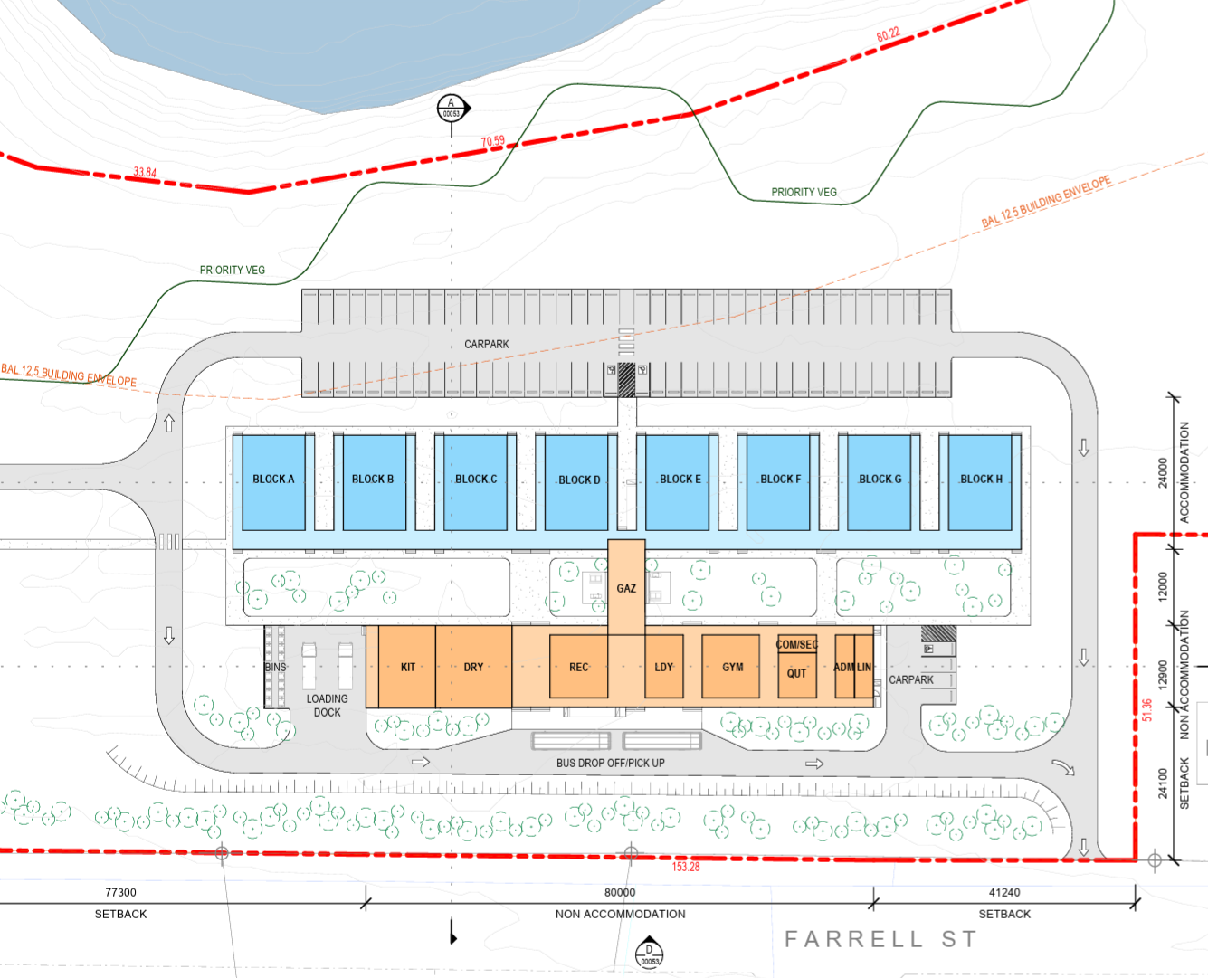








Accommodation Overview
Onsite Facilities
8 dormitory buildings each with 10 self-contained dorms
Dining area & kitchen
Laundry
Recreation area
Gym
Outdoor BBQ Area
Bus shelter
Car Parking

Slide 12
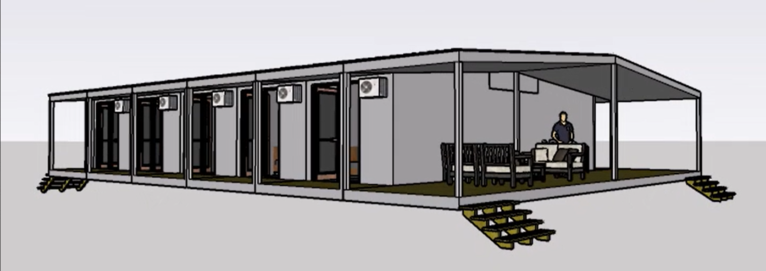
Indicative profile of dormitories
Dormitory buildings

Slide 13
Construction Timeline
Key Dates
January 2025 - Design and approvals started
March 2025 – Community engagement (any feedback to HT will be considered for the DA)
April 2025 – DA submission (input can be provided to Council)
November 2026 - Civil works start
December 2026 - Transport of buildings to Tullah
January 2027 – Accommodation installation and commissioning
June 2027 – Ready for operation
September 2027 – Bastyan Refurbishment (9 months)
September 2028 – Mackintosh Refurbishment (9 months)
June 2029 - move the facility to the Reece area

Slide 14
Important considerations
Development application phase:
Environmental and Natural values assessment
Bushfire Hazard Management Plan
Traffic Impact Assessment
Building permit application phase:
Noise & dust management
Waste management strategies
Review of underground services from past construction
Protection of biodiversity & local wildlife
Compliance with all WC regulations

Slide 15
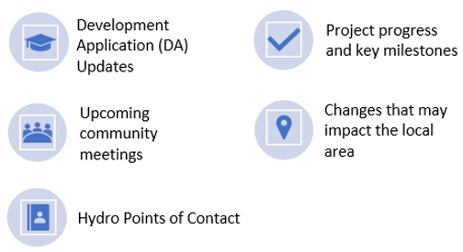


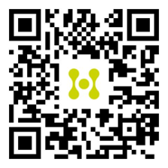
Next Steps & How to Stay Engaged
The Development Application for the project is expected to be submitted to Council in April 2025.
We welcome your feedback and encourage you to share your thoughts before the application is lodged. You can provide feedback directly to Hydro Tasmania through our project page. Your input is valuable in shaping the final submission.
What you’ll see on our project page:
Subscribe for updates or share your feedback online: connect.hydro.com.au/wcpowerhouse or by scanning our QR Code!
Some examples of what you could provide feedback on:
Preferred vegetation and landscaping
Parking and traffic considerations
Lighting for safety and visibility
Potential noise impacts from projects
New community benefits initiatives

Slide 16
Thank you! Please reach out if you have any questions or would like more information
Project Team contact details
Aline Puchalski (Project Manager): aline.puchalski@hydro.com.au
Engagement Team contact details
Breandan McKeown (Engagement Advisor): Breandan.McKeown@hydro.com.au
Anneke le Roux (Engagement Officer): anneke.leroux@hydro.com.au
Hydro Engagement Team: engagement@hydro.com.au

