Slide 1
Hazardous Chemicals
Storage, Maintenance and Management Guideline v1
  Level Two, Descriptive

Slide 2
Overview.
Provides general handling and use information regarding the hazardous chemical storage risks in the Hydro Tasmania workplace
Provides general information on the storage and management for hazardous chemicals including, flammables, aerosols, bulk containers, cylinders, placarding, and signage.
Provides general information on maintaining hazardous chemical controls such as bunds, spill kits, and emergency provisions.

Slide 3
Couple of Takeaways
    Store hazardous chemicals in accordance with the Safety Data Sheet (SDS).
    Incompatible chemicals must be segregated when stored
    Hazardous chemicals should be stored in appropriate storage locations (e.g., flammable lockers, cabinets, stores)
    Hazardous chemicals must be contained in safe containers (i.e., containers that are in sound condition and compatible with the chemical).
    Hazardous chemical containers must be appropriately labelled.
    Hazardous chemicals stored in bulk have additional requirements (e.g., installation of placarding and signage, secure storage, and segregation requirements).
    Bunding and encapsulation systems apply for different classes of hazardous chemicals: These must be maintained so they remain effective.
Even when not in use, chemicals can still pose a risk!
When incompatible chemicals mix, they may:
ignite or explode
release toxic, flammable or corrosive gases, or
corrode chemical containers, causing them to leak.

Slide 4
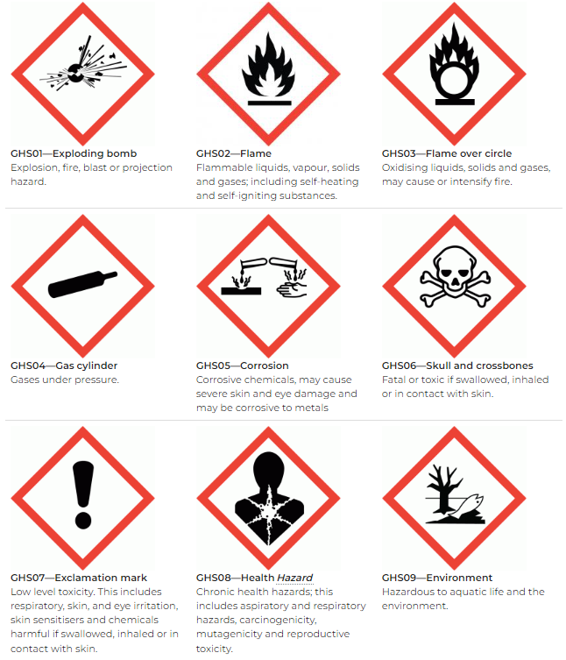
What is a Hazardous Chemical?
    A hazardous chemical is any substance or thing that has been classified as a hazardous chemical under a system called the Globally Harmonised System of Classification and meets other requirements outlined in the WHS Regulations.
    In general, a hazardous chemical is a substance that can cause harm to health or the environment due to its physical, chemical or toxic properties.
    A simple way to identify if a substance is hazardous is to check the product label or the product’s Safety Data Sheet (SDS):
      In Australia, a hazardous chemical must include the relevant hazard category pictograms on its label (see right).
      Section 2 of the SDS will identify whether the substance is hazardous and identify the relevant hazards.

Slide 5
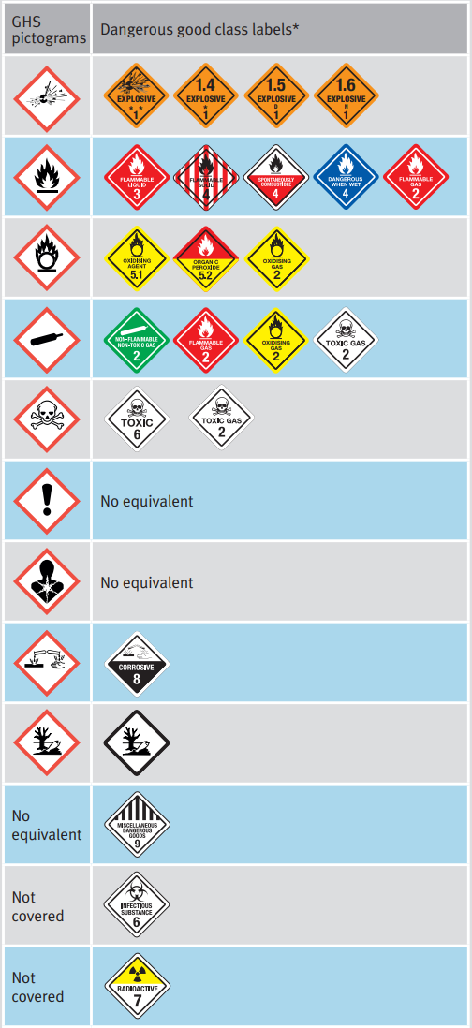
What is a Dangerous Good?
    A Dangerous Good is slightly different to a Hazardous Chemical and relates to products classified as dangerous to transport by road, rail, sea or air.
    Many chemicals are classified as both a hazardous chemical and as a dangerous good.
    The Australian Dangerous Goods Code applies when transporting these items.
    The dangerous goods class labels or placards (see right) are used when transporting dangerous goods and also when storing dangerous goods in large quantities (called placard quantities).
    The information on the placards assists emergency services respond appropriately in the case of a spill or emergency.
    Section 14 of the Safety Data Sheet (SDS) will outline whether a chemical is a Dangerous Good.

Slide 6

How do we find information on a chemical?
Manufacturers and Suppliers of hazardous chemicals are required to produce and provide a document called a Safety Data Sheet or SDS.
An SDS is a document that provides detailed information about a hazardous chemical for the purposes of safe use, storage, transport and emergencies.
The supplier of a hazardous chemical must provide a copy of the SDS when supplying the product to the workplace.
At Hydro Tasmania, we use a software package called Chemalert to manage our SDS database chemical registers, product labelling and risk assessments for products we store and use.

Slide 7
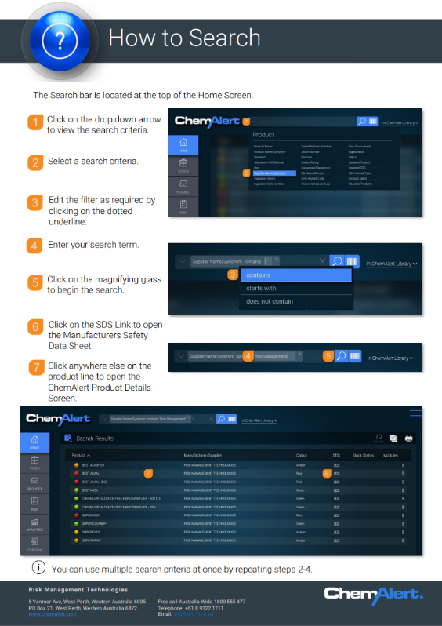
How do we find an SDS?
Access to the Chemalert site and a set of useful “how-to guides” is available via the “Chemicals and Hazardous Substances” tile on the WHS “Specific Risks” page.
Follow the instructions in the “How to Search” guide which outlines how to find a product and its SDS.

Slide 8
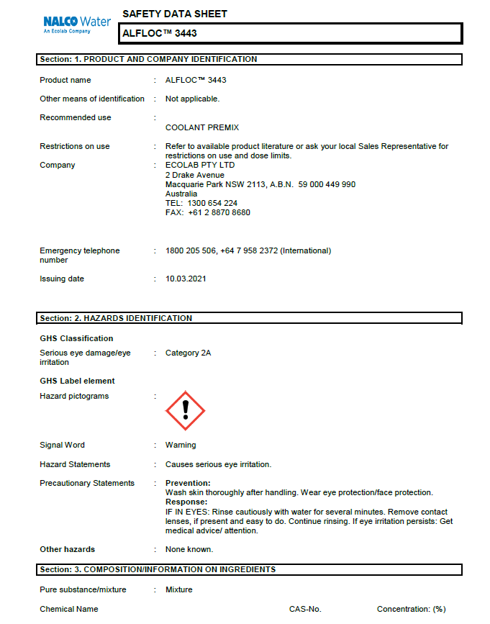
How does a Safety Data Sheet help you?
All SDS, regardless of manufacturer, are required to include the following 16 sections to help you safely handle, store and use that product:
Identification Hazards Identification Composition/Information on ingredients First Aid Measures Fire-Fighting Measures Accidental Release measures Handling and Storage Exposure Controls / Personal Protection | Physical and chemical properties Stability and reactivity Toxicological information Ecological information Disposal considerations Transport information Regulatory information Any other relevant information

Slide 9
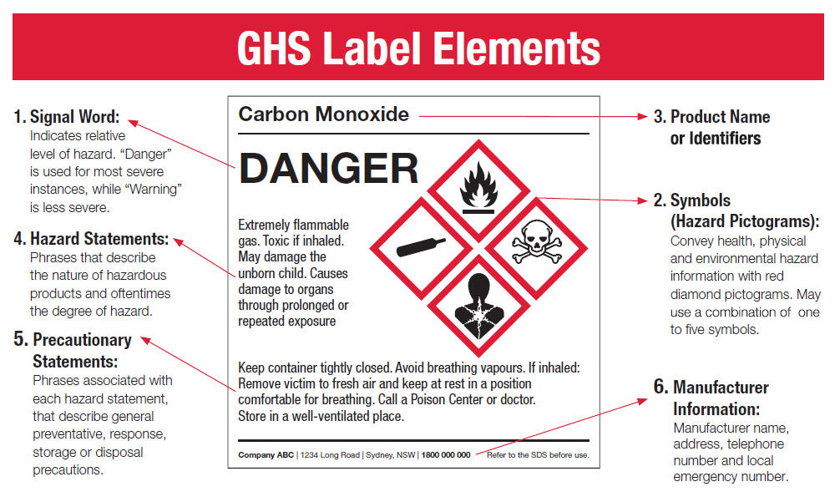
How to read a label for a hazardous chemical – GHS

Slide 10
Signage, Placards and Labelling.

Slide 11
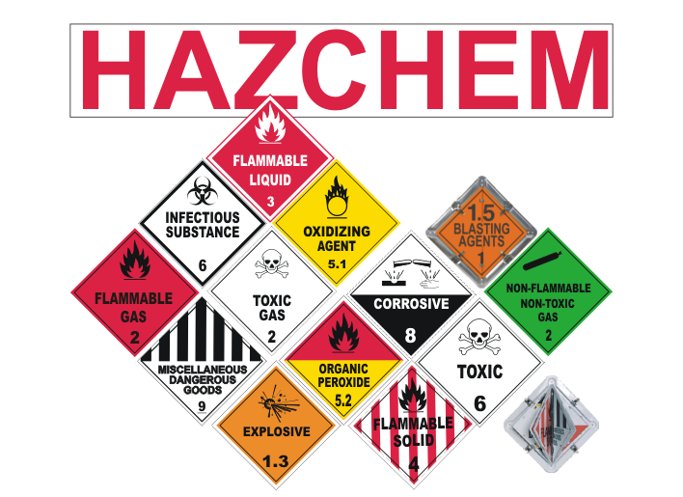
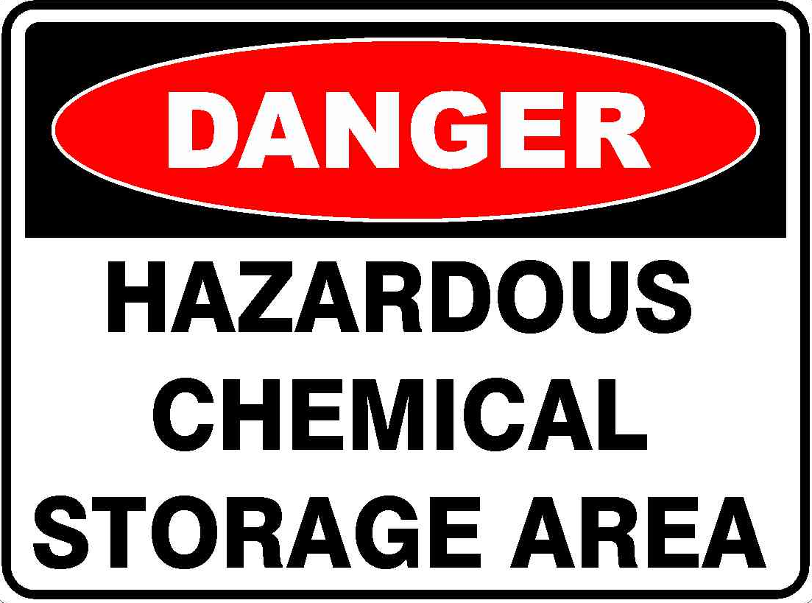
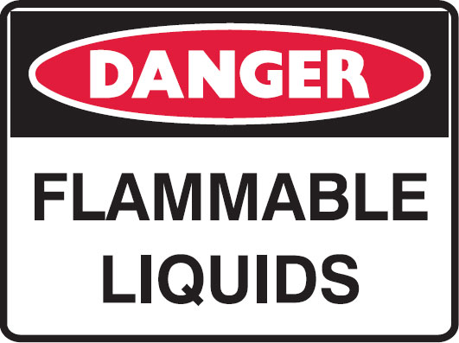

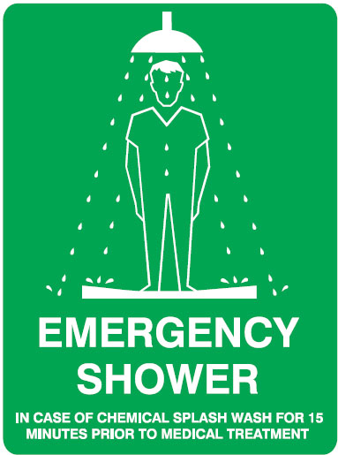
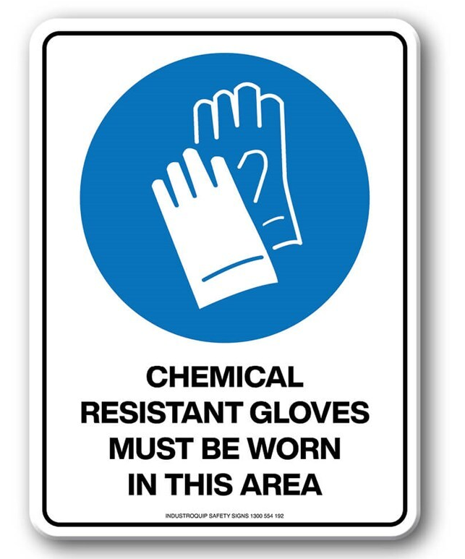
What Safety Signs are Required?
There are 2 broad types of safety signage required in workplaces that store and use hazardous chemicals. These are safety signs and placards.
Safety signs provide information to workers and visitors about how they can manage risks from hazardous chemicals.
Placards provide information to emergency service workers.

Slide 12
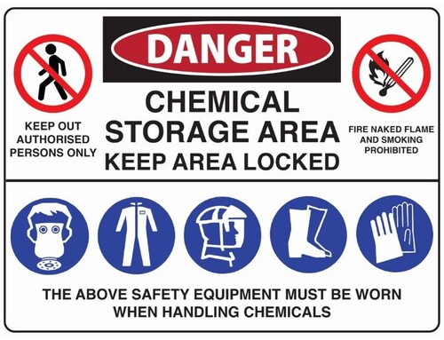

What are Safety Signs for?
Safety signs are a risk control measure for using, handling, generating and storing hazardous chemicals.
They provide:
    Warnings about hazards
    Emergency response information and locations
    Information about responsibilities related to hazardous chemicals
    Safety signs are to be displayed next to the hazard or entry to the storage location so that it is clearly visible to people approaching the hazard

Slide 13
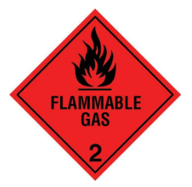
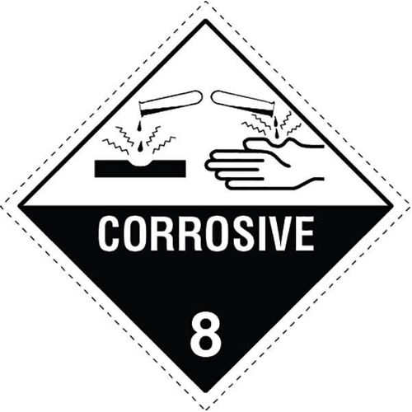
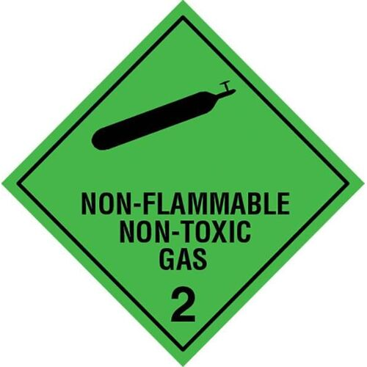
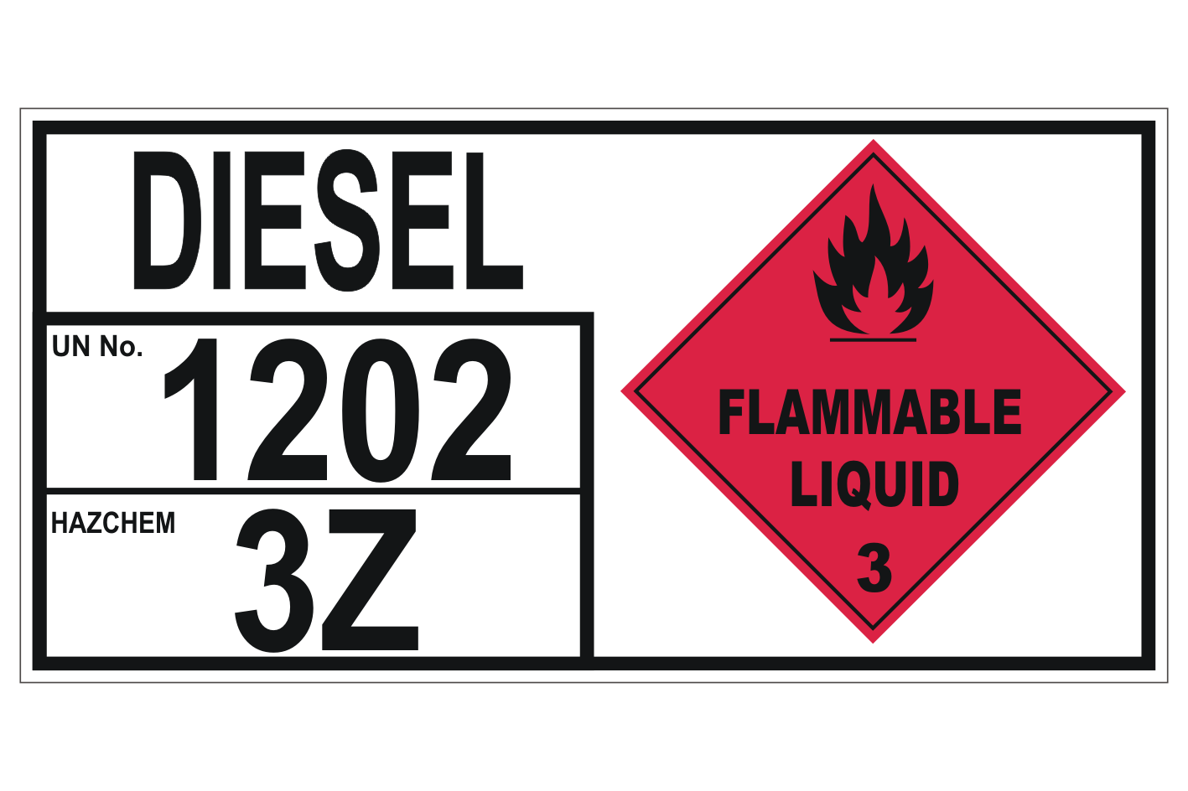
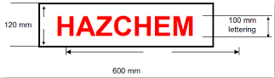
What are Placards for?
Placards must be installed where hazardous chemicals are stored in quantities that are in excess of those outlined in the WHS Regulations.
A section of the regulations called Schedule 11 outlines different categories of hazardous chemicals and the quantities where placards are required.
Placards use the form, dimensions and class labels as set out in the Australian Dangerous Goods Code.
There are different types of placards. Most commonly at Hydro, you will see:
Outer warning placards
Bulk Storage / Container placards
Placards for packaged goods
Placards for flammable liquids category 4 (diesel)

Slide 14
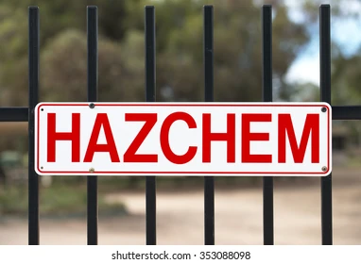
Outer Warning Placards
An outer warning placard is required at each entrance to the workplace where hazardous chemicals are stored in excess of the placard quantities for a hazardous chemical outlined in schedule 11.
An outer warning placard must meet the requirements in the image below.

Slide 15
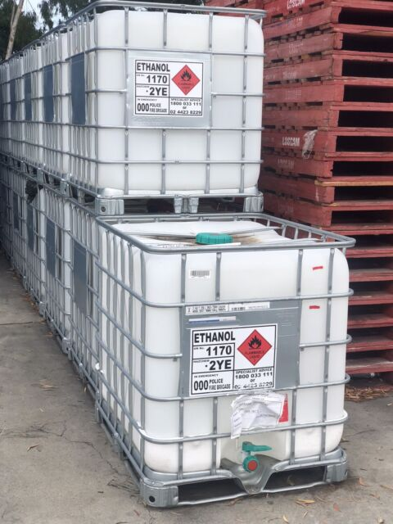
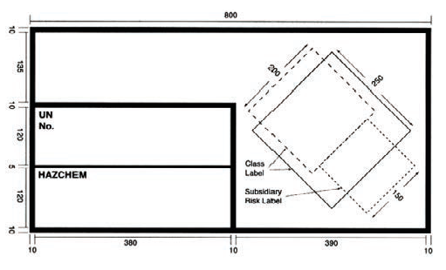
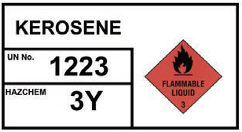
Bulk Storage / Container Placards
Bulk storage placards are required when hazardous chemicals are stored in bulk containers such as tanks or Intermediate Bulk Container’s (IBC’s).
Where the storage vessel is over 500kg or Litres, a placard which meets the requirements below must be displayed on or next to the tank, container or storage area.

Slide 16
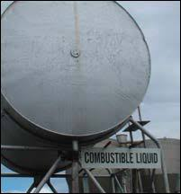

Combustible Liquid Placards
Where Flammable Liquid Category 4 are stored, the “combustible liquid” placard as shown below must be displayed on or next to the container or storage area.
Diesel is a good example of a Flammable Liquid Category 4.

Slide 17
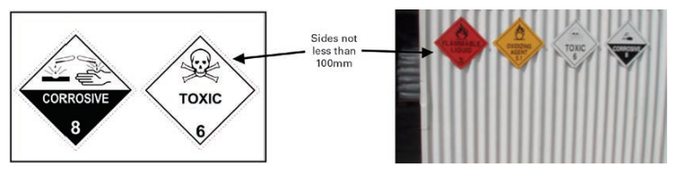
Placards for packaged goods
Where we are storing placard quantity hazardous chemicals in containers with a capacity of less than 500kg or 500 litres, the storage area must display an information placard for the relevant chemicals as shown below.
The placard must be displayed on a white or silver background.

Slide 18
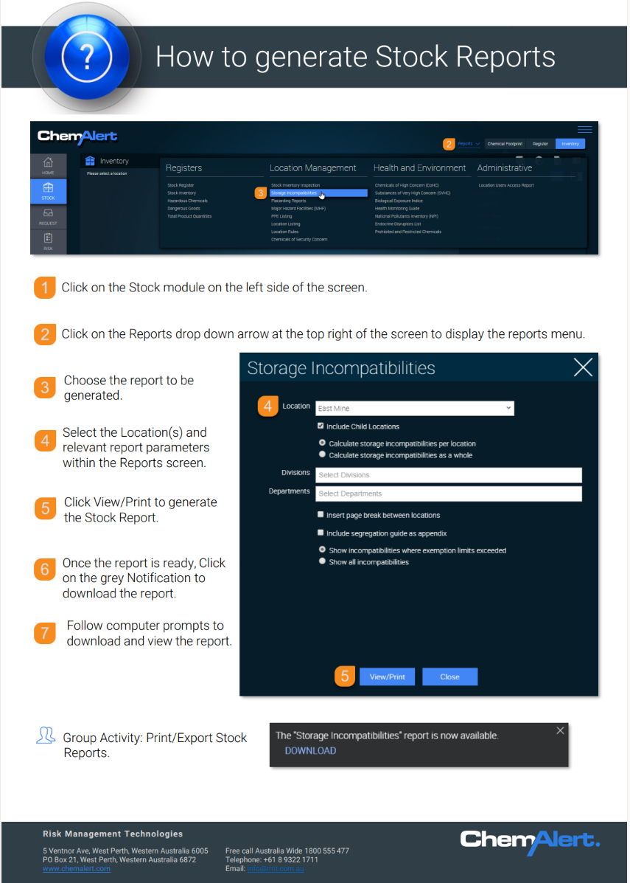
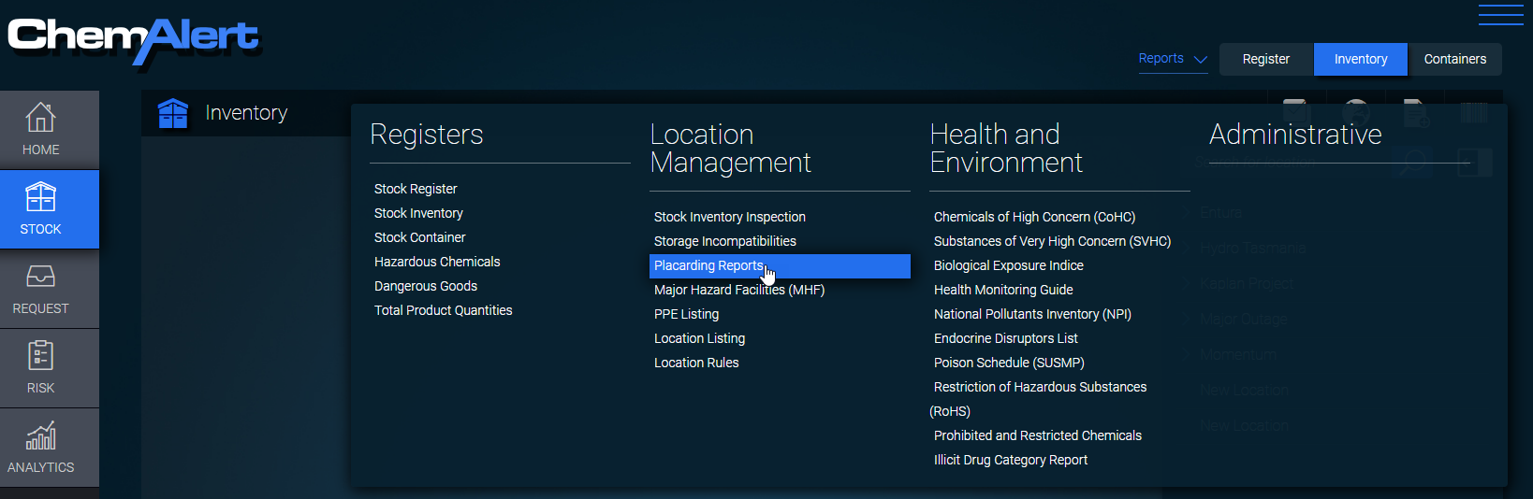
Chemalert Placard Report
To assist in identifying the placards that would be required, you can run a Placarding Report by following the instructions outlined in the “How to generate Stock Reports” and selecting the “Placarding Reports” from the reports drop down

Slide 19
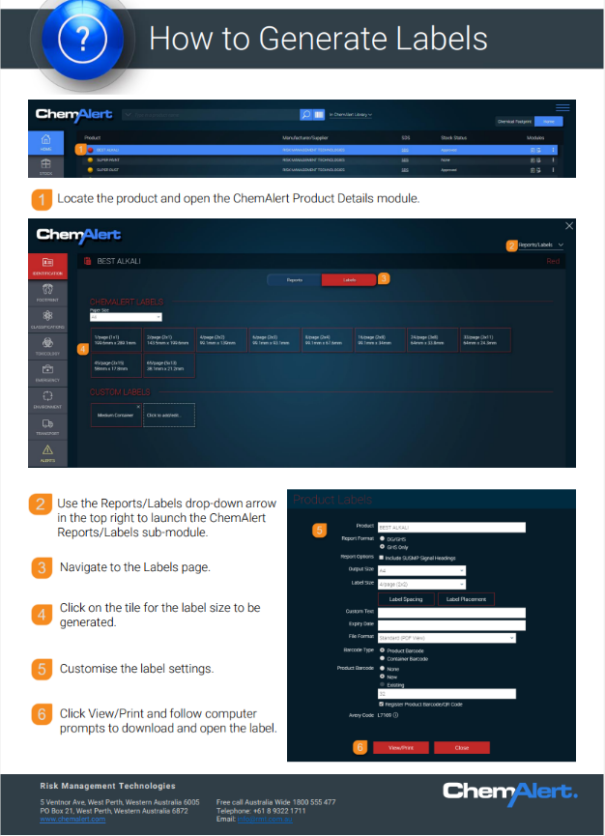
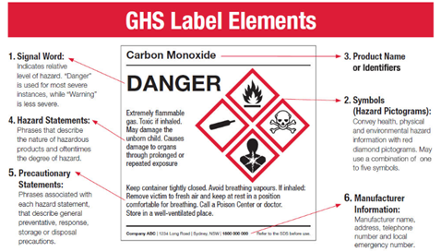
Hazardous Chemical Labelling
Labels on chemical containers and pipe work must meet the requirements of the Globally Harmonised System (GHS) of classification and labelling of chemicals.
Hazardous chemicals which are decanted into a new container must have a label attached which complies with the GHS (unless used immediately and the container cleaned so that is as if the container never contained the chemical)
Labels can be printed through Chemalert by following the “How to Generate Labels” guide.

Slide 20
Storage

Slide 21
Why is it important to store hazardous chemicals correctly?
Correct storage of chemicals is important to reduce the likelihood of spills or leaks occurring and to reduce risks related to fire or other emergency situations.
There are many controls that can be in place to help ensure these risks are managed during storage. Some of these to be covered here include:
Segregation or separation of chemicals
Storage containers
Storing chemicals in bulk
Bunding

Slide 22
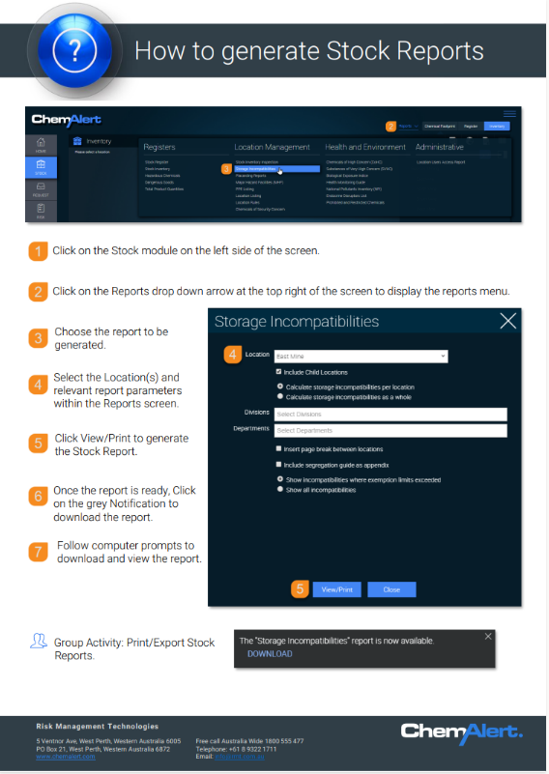
What is segregation?
Segregation is the process of separating or isolating incompatible substances.
It is one method used to reduce the likelihood that incompatible substances could mix and cause a reaction such as an explosion or releasing toxic, flammable or corrosive gases.
In general, segregation charts can assist in the identification of incompatible substances or groups of chemicals that should be stored separately.
Chemalert can also assist in identifying incompatible substances by running a Storage Incompatibilities report. The instructions for this can be found in the “How to generate Stock Reports” guide.
Note that rules for storage of what are considered “minor storage” quantities allow for some flexibility when storing incompatible substances together. However, where proper storage cabinets or enough space is available, the segregation rules should always be followed.

Slide 23
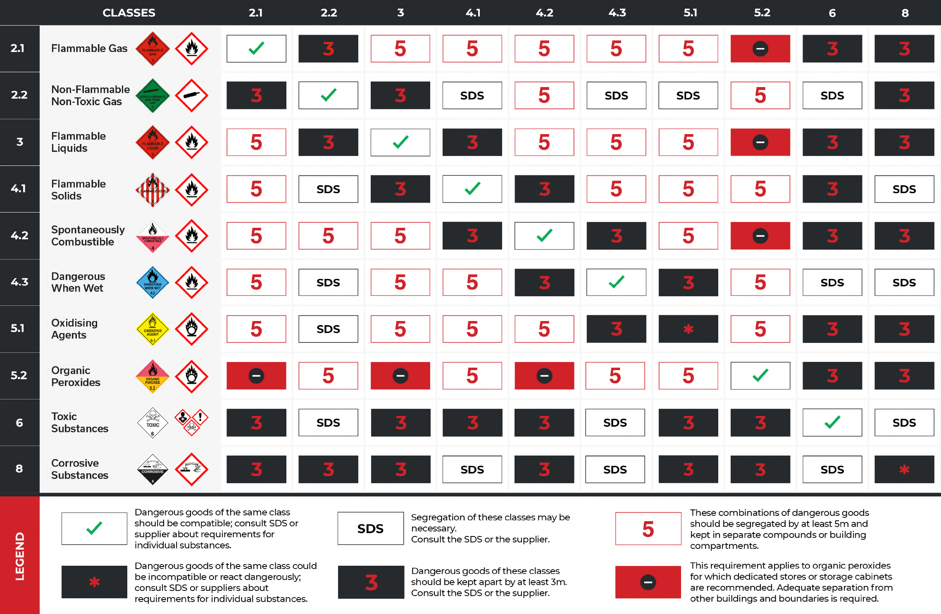
Segregation Charts
Segregation charts, like the one shown here, provide general guidance around what substances may be incompatible.
Find each of the classes of substance you are checking the compatibility for by looking at the SDS (See section 14 for Dangerous Goods classification).
Where they intersect on the chart will inform you of the segregation requirements.
In all cases, it is recommended to check the SDS for storage information (further handling and storage information is available in section 2 and section 7 of the SDS).

Slide 24
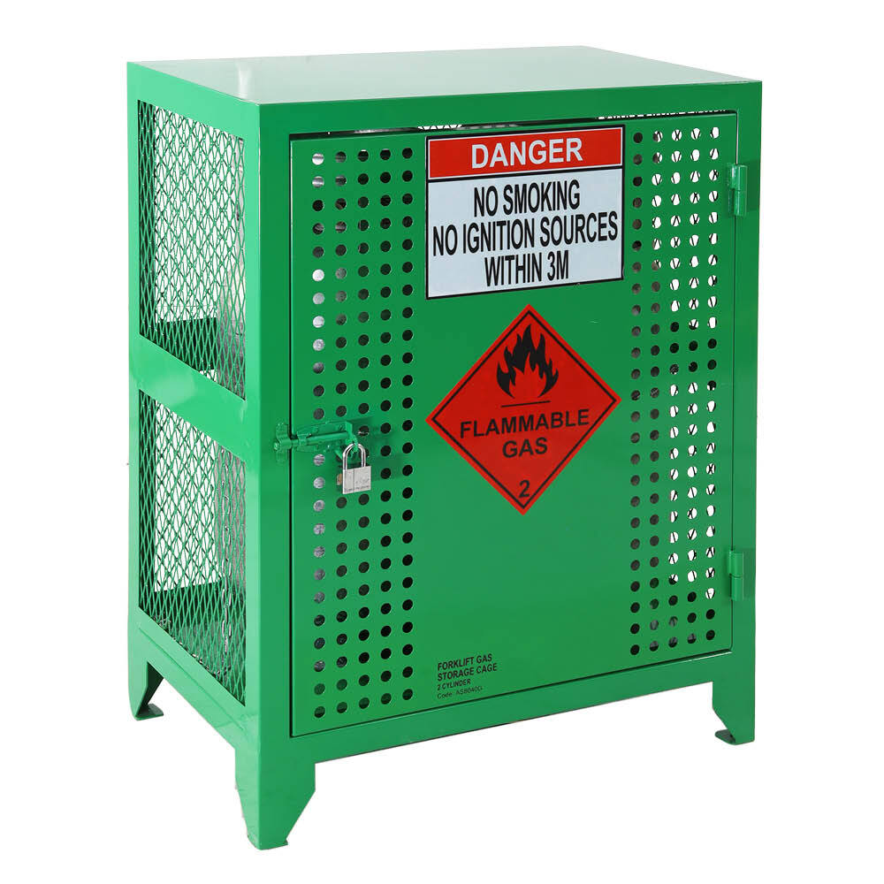
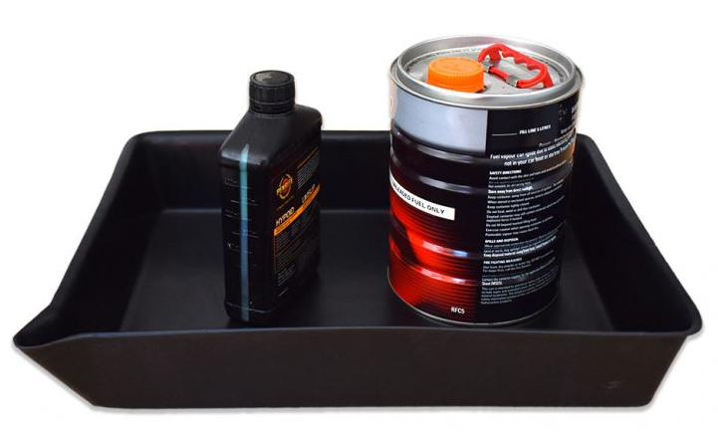
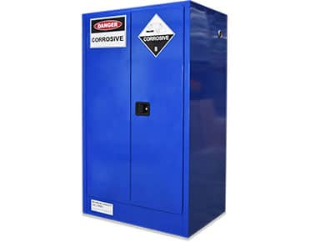
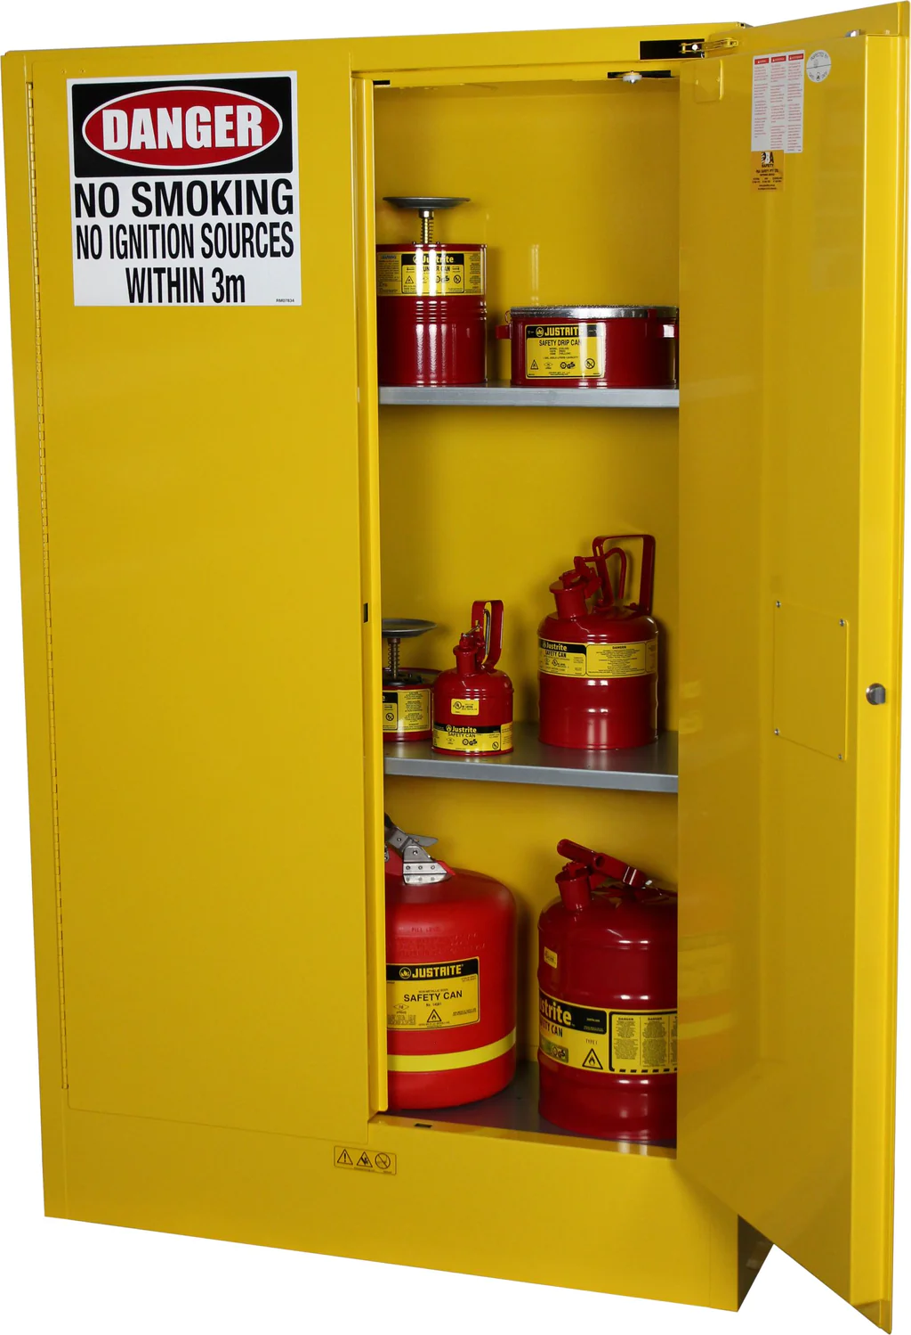
How to Segregate
At Hydro Tasmania, the easiest method to ensure that we are segregating our chemicals correctly is to ensure we are storing the correct chemicals in the correct storage locations.
Using the supplied chemical storage cabinets and checking the SDS to check for any subsidiary risks that need to be accounted for (some chemicals may have more than 1 risk).
Where cabinets are not available, general principles of segregation should apply, such as:
Ensure incompatible substances are sufficiently separated by distance or a physical barrier.
Ensure storage containers are in good condition
Ensure there is bunding or some form of spill containment in place
Ensure incompatible substances are not stored above each other

Slide 25
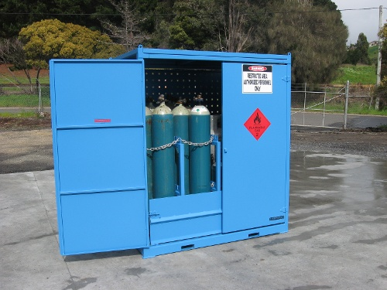
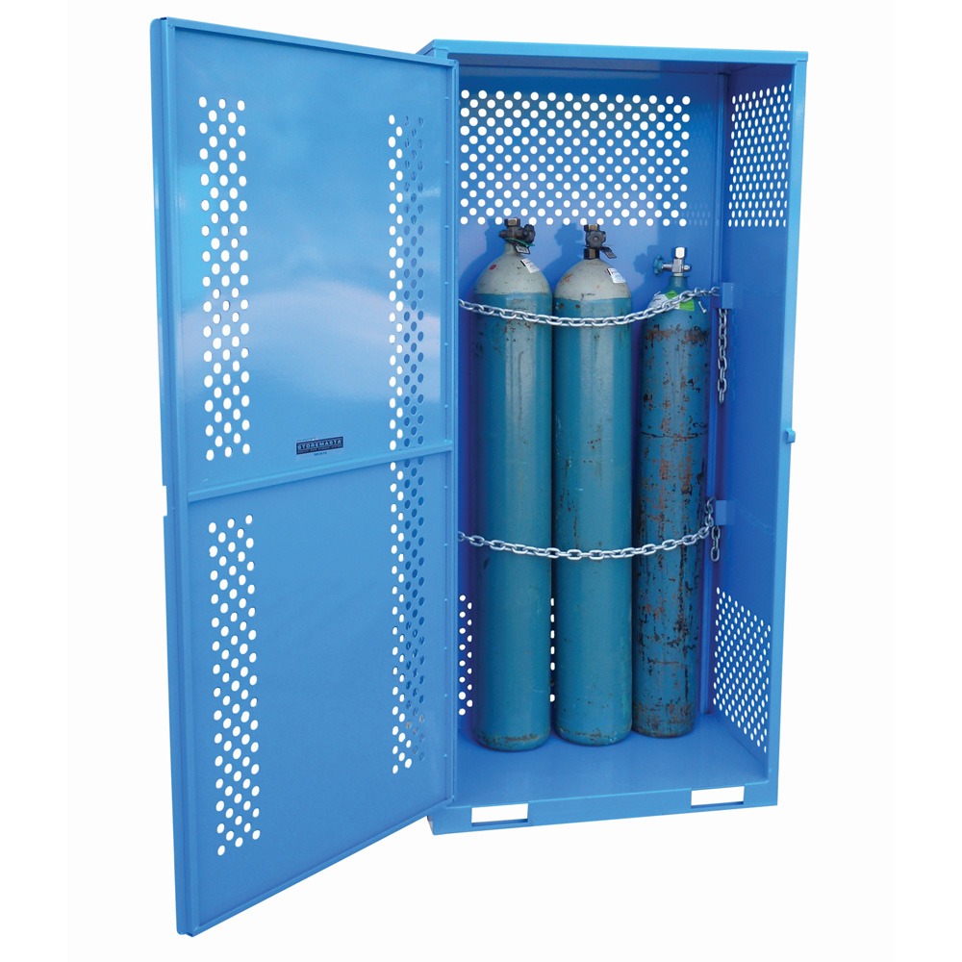
Gas Cylinder Storage
Cylinders should be stored vertically (Acetylene and LPG must never be stored horizontally).
Gas cylinders are best stored outside or in an open and well-ventilated location with some weather protection, in dedicated cage or storage area with securing chains
Cylinders should be stored away from heat sources and from vehicle or machinery traffic.
Empty cylinders should be clearly labelled or stored separately from full cylinders.
Segregation requirements for empty cylinders are the same as for full.
Gases must be segregated by their hazard class (flammable, toxic, oxidising) and separated by at least 3 metres or a purpose-built screen wall.

Slide 26
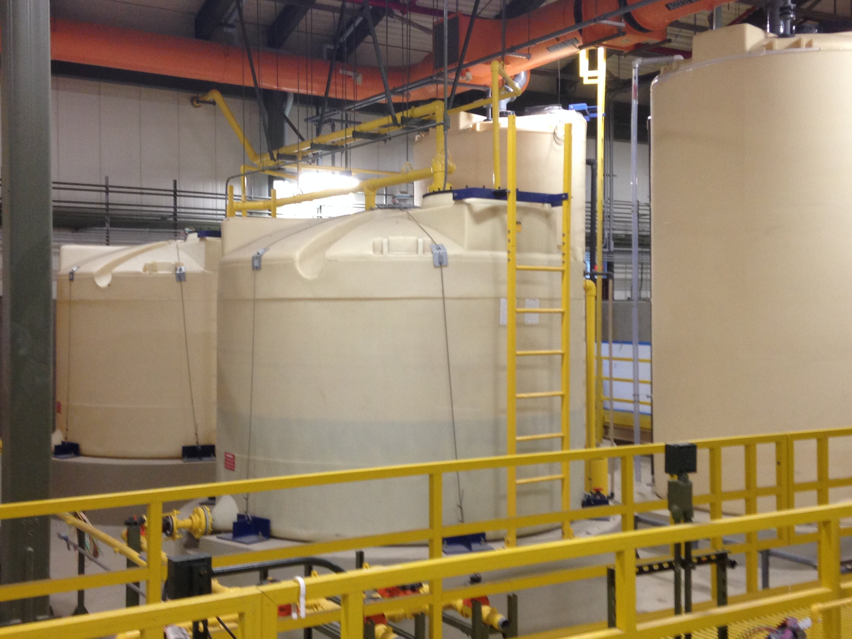
Bulk storage
Key requirements for Bulk chemical storage
Hazardous chemicals are stored in bulk if it’s in:
      a container with a capacity over 500L or 500kg or
      an undivided quantity over 500kg, if the chemical is a solid.
Bulk storages of Hazardous chemicals must be:
      securely stored to prevent spills and contamination.
      segregated from incompatible materials; and
      identified with appropriate signage and placarding.
Workplaces must also keep a manifest when storing hazardous chemicals above a certain amount.

Slide 27
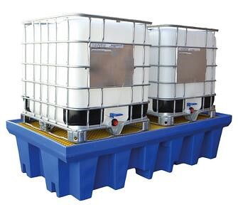
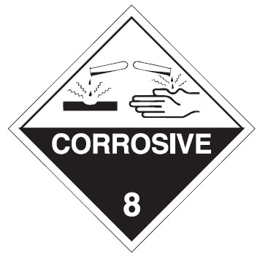
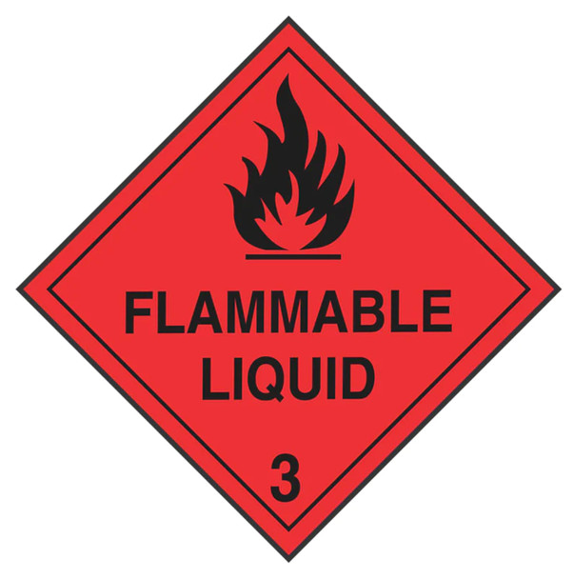
Bunds and encapsulation systems
Bunding provides an impervious barrier that chemicals will not be able to pass through.
Bunds are designed to:
      Contain the leak or spill
      Minimise the risk of fire or explosion
      Aid the recovery and clean-up of chemicals
Two of the most common class of chemicals requiring bunding in Tasmania Hydro workplaces are:
      Class 3 Flammable liquids and
      Class 8 Corrosives.
The bunding requirements for these classes are summarised on the following pages.

Slide 28
Bunds and encapsulation systems
Class 3 Flammable liquids (AS 1940:2017 )
The capacity (of the bund) shall be at least 100% of the largest package, plus 25% of the aggregate capacity (up to 10 000 L), together with 10% of the capacity (10 000 L – 100 000 L) and 5% (above 100 000 L).
This capacity shall be increased by volume equal to the output of auto or manual fire suppression systems over a 20-minute period. Drainage should be capable of carrying this output.
If there is more than one storage connected to the common compound, drainage tank or pit, the capacity of the compound shall be equal to the largest compound for any one store, plus 20% of the capacity of the other stores.

Slide 29
Bunds and encapsulation systems
Class 8 Corrosives (AS 3780:2008)
The net capacity of the compound must be not less than 25% of aggregate volume of liquids, or of the capacity of largest container (whichever is the greater) — and must not exceed 5000 L where only packages are kept.
Racks or shelves must be designed and constructed to prevent the accumulation or pooling of liquid, except where they're designed as spill trays or compounds.
The following items shall be provided within 10m of, (but not nearer than 2m) where packages are opened:
    An emergency shower and Eye wash facilities complying with AS4775
    Water for washing hands
    Appropriate gloves for handling the chemical
Acids and Alkalines (bases) are both Class 8 hazardous chemicals however they cannot be stored together.

Slide 30

Managing Acids and Alkalines
The following acids and alkalis are found in the Hydro Tasmania workplace:
The segregation chart in this guideline has the following instruction for storing Class 8 items together:
Alkalines | Acids
Sodium Hypochlorite | Hydrochloric Acid
Sodium Hydroxide
Dangerous goods of the same class could be incompatible or react dangerously; consult the SDS or suppliers about requirements for individual substances

Slide 31
Transport

Slide 32
Dangerous Goods Transport
The Australian Dangerous Goods Code sets out the National Standards and requirements for transporting dangerous goods by road or rail.
National and State legislation regulates how these codes are applied and may differ slightly from state to state.
As the risk relating to transport of dangerous goods increases, (ie. more dangerous substances, mixed loads, larger quantities), so too does the level of control required to manage the risks.
In Tasmania, vehicles and drivers transporting dangerous goods must be licensed by WorkSafe Tasmania if the capacity of the containers:
      exceed 500 litres or kilograms for a container
      exceed 3000 litres for a single IBC (Intermediate Bulk Container) or total capacity of IBCs, not filled or emptied on the vehicle
      are a Risk Category 3 load for Class 1 (explosives)

Slide 33
Dangerous Goods Transport
There are 5 basic categories of dangerous goods transport:
Exempt quantities: Dangerous goods in very small quantities that pose minimal risk during transport.
Tools of Trade: Small amounts of dangerous goods used as part of a person's job, with certain conditions for safe transport.
Packed in Limited Quantities: Small individual packages packed together in boxes and having reduced transport requirements under the code.
Less than Placard: Amounts of dangerous goods that fall below the threshold for requiring placards, but still have transport requirements such as transport documentation.
Placard: Larger quantities of dangerous goods that require the display of warning placards on the vehicle or container.
The Chemical Transport Checklist and the Dangerous Goods Transport Assessment Tool should be used to assist with Dangerous Goods and chemical transport requirements.

